Slide 1
LIFELONG LEARNING
4th Semester Mini Project under supervision of
Dr. Indrajit Banerjee
group MEMBERS
Soumyaditya mondal <2021ITB052>
Ayush Raj <2021ITB016>
Aayush Kumar <2021ITB026>

Slide 2
CONTENT
Introduction
Importance of LL in real world application
Challenges in LL including catastrophic forgetting and bias
Several approaches to LL
Uses and examples of LL
About Implemented Lifelong Learning Model
Future scope in LL
Conclusion

Slide 3
INTRODUCTION
What is lifelong learning ?
Lifelong learning is basically a continuous learning process where some knowledge is accumulated and maintained in knowledge base(KB) and from that previous knowledge for the purpose of future learning or discovering some new task is called lifelong learning
A subdomain of future learning.
Improve the model performance from the experience gained from the job training and open environment.

Slide 4
Key characteristics of LL can be mentioned as:
(a) continuous learning process
(b) knowledge accumulation and maintenance in the KB
(c) the ability to use the accumulated past knowledge to help future learning
(d) the ability to discover new tasks
(e) the ability to learn while working or to learn on the job

Slide 5
PARTS OF A LL-MODEL
Knowledge Base (KB)
store previously learned knowledge.
Its subparts: a) Past Information Store b) Meta-Knowledge Miner
c) Meta-Knowledge Store d) Knowledge Reasoner
Knowledge-based Learner
- helps to use prior knowledge to learn new task.
Task-based Knowledge Miner
mines knowledge to from KB.
Model
is a learned model
Application
is real-world application for the model
Task Manager
receives and manage the tasks that arrive in the system.

Slide 6
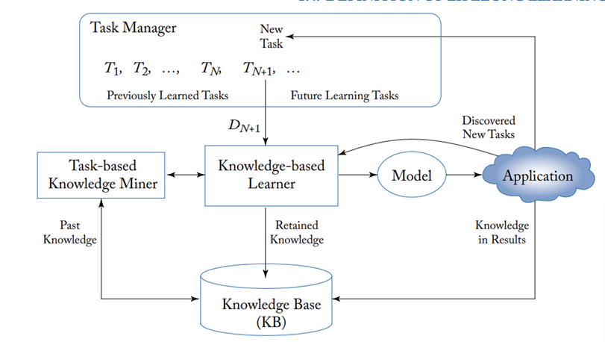
LL-MODEL DIAGRAM

Slide 7
Importance of LL in real world application
Healthcare
By continuously learning from new patient data is incorporated into the system.
Finance
By predicting financial market trends and risks, it helps the investor in real-time market data.
Can predict more accurate healthcare recommendations.

Slide 8
Autonomous Vehicles
Improve performance and safety of autonomous vehicles by learning the scenarios and adapting to changes of road conditions.
Customer Service
Interaction with customers and feedback becomes easy and efficient.
Easy to understand customers’ needs and preferences.

Slide 9
Challenges in LL including catastrophic forgetting and bias
Catastrophic Forgetting
System forget previously learned information while trained by new data.
Limit system ability to adopt to new situations and make accurate predictions
Bias
Impact the model’s ability to make accurate predictions or recommendations.

Slide 10
Several approaches to LL
Regularization
- technique that aims to prevent overfitting of the model to the data by adding a regularization term to the loss function.
- prevent the model form catastrophic forgetting.
Rehearsal
- the system can prioritize the most important past experiences and retain important knowledge.
Transfer Learning
- use previously learned knowledge into the new dataset training.

Slide 11
Uses and examples of LL
Aspect Extraction
(discovers the entity and entity attributes/features)
Determining whether the opinion about aspect is positive, negative or neutral.
Rule-based Approach It is very hard to write rules to cover all possible scenarios on the road
Learning-based Approach It also have similar issue because the road environment is highly dynamic and complex.
Sentiment Analysis
Self-driving Cars
Chatbots
We need to ensure that it learns new knowledge during the conversation.

Slide 12
About Implemented Lifelong Learning Model
Collect Dataset
Collects diabetes data of fixed-width file format from ‘https://archive.ics.uci.edu/ml/datasets/Diabetes’
Dataset to Data frame
Using ‘read_fwf’ function of Pandas library.
Data Analysis
Arrange the dataset using feature selection method as per model design.
Features Splitting
Split the target and corelated features in the dataset.

Slide 13
Limit the data range to avoid high variance problems.
Split the whole data by 4:1 ratio.
Train Test Split
Standardization
Using ‘SGD Regression’.
Calculated by R2 score.
Accuracy Calculation
Model Training
Train the model again & again with similar dataset to improve model performance.
Implementing LL Model

Slide 14
Future scope in LL
Explainable and Transparent LL
Develop algorithms that are transparent and can provide explanations for their decision-making processes.
Meta-Learning
Adapt quickly to new tasks or environment
Hybrid Approach
Combines different learning paradigms that lead to more efficient and effective LL systems.

Slide 15
Learning from Multi-Model Data
Learn from multi-model data like text, image and audio to improve the performance and capabilities.
Collaborative LL
Involve multiple systems learning and sharing knowledge with each other to lead efficiency in complex and dynamic environment

Slide 16
Conclusion
LL Machine Learning holds significant promise for developing intelligent systems that can improve and evolve continuously over the time
It is also opening up exciting possibilities for innovation and progress in the years ahead.

Slide 17
References
Chen, Zhiyuan & Liu, Bing. (2016). Lifelong Machine Learning. Synthesis Lectures on Artificial Intelligence and Machine Learning. 10. 1-145. 10.2200/S00737ED1V01Y201610AIM033
Source for the Dataset used for training the model: ‘https://archive.ics.uci.edu/ml/datasets/Diabetes’

